Slide 1
Reading Visual Arts
GEE 13 D_ Week 2
Definition , Visual Art Forms, Function and Purposes, Elements of Art, Practice_ Seatwork

Slide 2
We are discussing the following topic
What are the Visual Art Forms
Reading Visual Arts Definition
Purposes of Visual Arts
Practice reading visual
The Elements of Art
Seatwork

Slide 3
Visual Art ( classification)
Is one of the art classifications that is perceived by viewing/seeing like painting, drawing, printmaking, sculpture, photography, graphic arts, moving images, video making, filmmaking, fashion arts, crafts, and architecture as art forms

Slide 4
Reading Visual Arts
Is the ability to read, analyze, and critique works of visual arts. Reading is the process of forming a perception based on the text’s imagery, form, and language translated through the reader’s experience ( Cramer, Ortieb, and Cheek 2007 ). On the other hand, Visual Reading is the ability to find meaning through imagery. Human reads not only texts but also images

Slide 5
Purposes of Visual Arts
1. CEREMONIAL PURPOSES- some visual arts are used to celebrate an event, a season, or an era. These are used to celebrate something significant in terms of worship or culture
Ex: patron festivals, parade, adornment on religious scrolls, masks
2.ARTISTIC EXPRESSIONS – Some visual arts are used for self-expression. Arts can convey emotions, experiences, and ideas
Ex: Painting, photography, performing arts
3. NARRATIVE PURPOSE- To tell a story, use illustrations to describe experiences and communicate ideas
for example in books, komiks, painting

Slide 6

1. CEREMONIAL PURPOSES-
some visual arts celebrate an event, a season, or an era. These are used to celebrate something significant in terms of worship or culture
Ex: patron festivals, parades, adornment on religious scrolls, masks

Slide 7
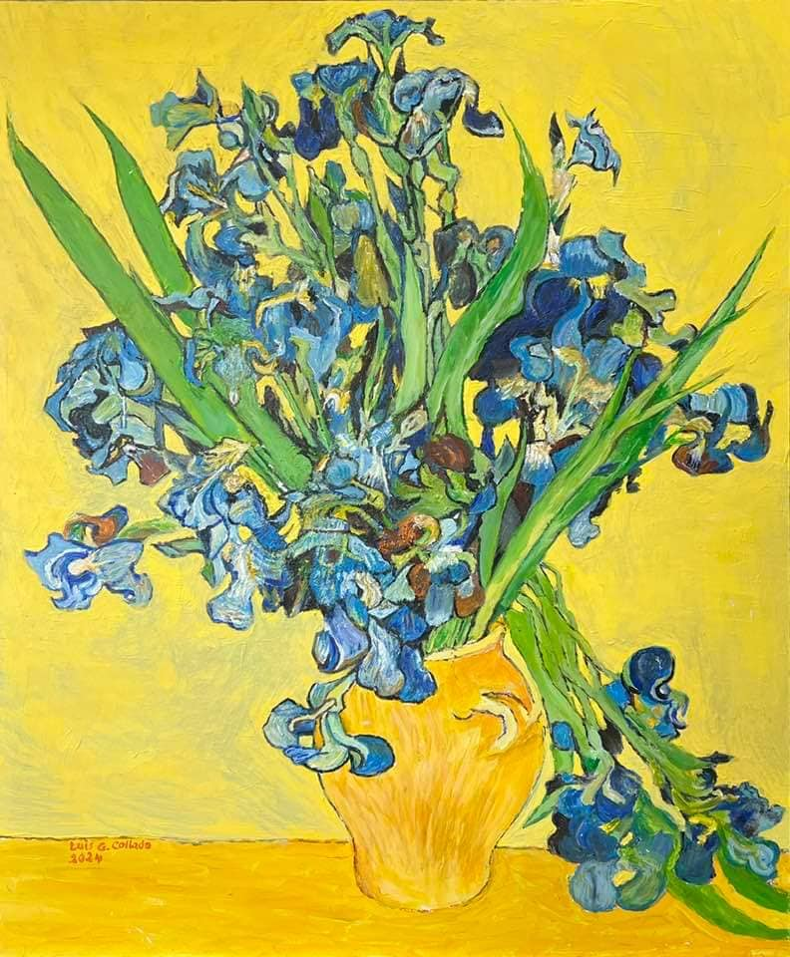
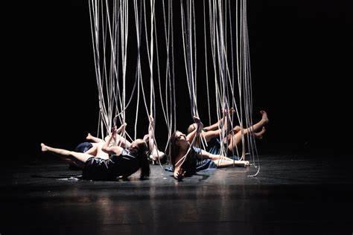
2.ARTISTIC EXPRESSIONS
Some visual arts are used for self-expression. Arts can convey emotions, experiences, and ideas
Ex: Painting, photography, performing arts

Slide 8
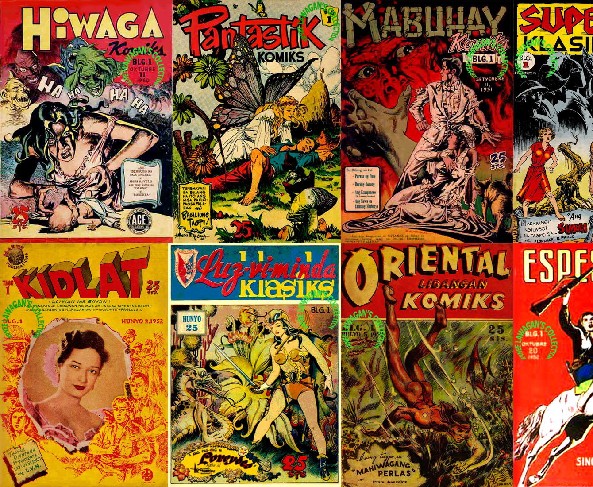
3. NARRATIVE PURPOSE-
To tell a story, use illustrations to describe experiences and communicate ideas
for example in books, comics, painting

Slide 9
Purposes of Visual Arts
4.FUNCTIONAL VISUAL ARTS- beautify things that can be used in everyday life. Like the furniture, pottery, and jewelry that have functions
Ex: Interior_ Display in houses/malls and museums, decorative art in the human body, crafted furniture
5. PERSUASIVE ARTS – used to promote philosophies, products, ideas, ideologies, goals, and designs
Ex: Advertising, propaganda, marketing products
6. CONVEYANCE OF BEAUTY – represent beauty for its own sake--- expression
Ex: face and body makeup, fashion, decorative body accessories

Slide 10
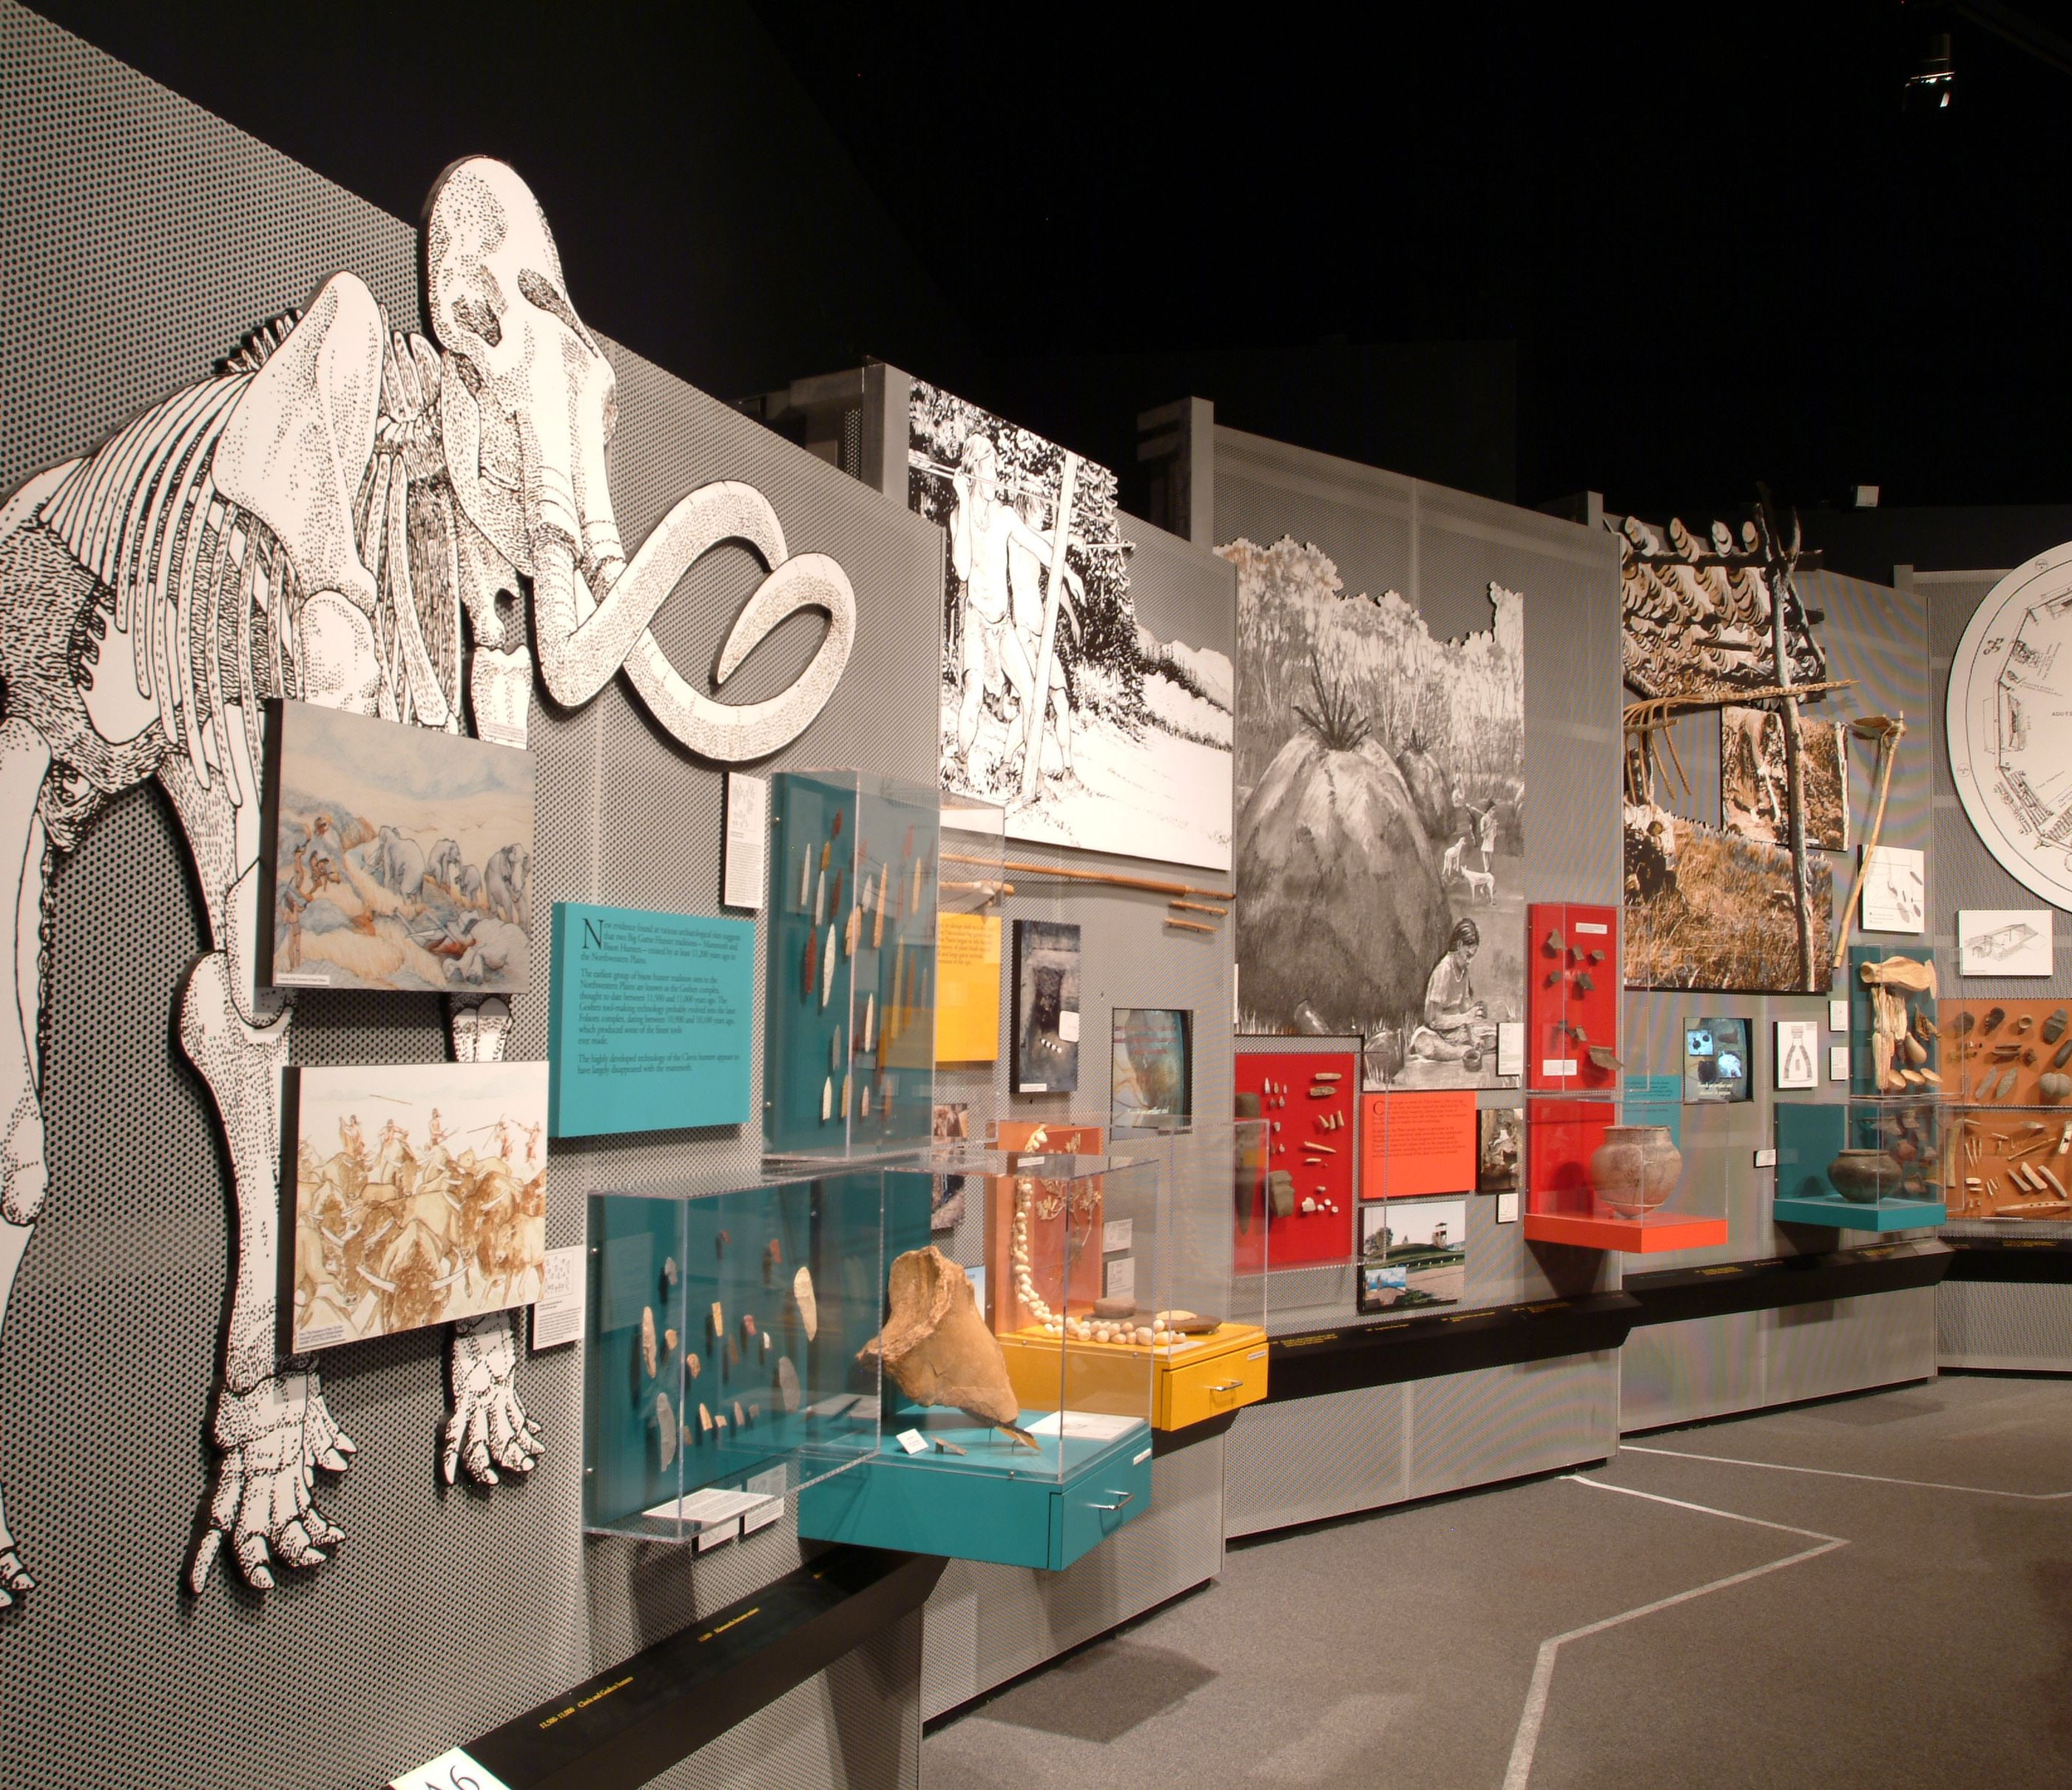
PURPOSE of VISUAL ARTS
4.FUNCTIONAL VISUAL ARTS- beautify things that can be used in everyday life. Like the furniture, pottery, and jewelry that have functions
Ex: Interior_ Display in houses/malls and museums, decorative art in the human body, crafted furniture

Slide 11

5. PERSUASIVE ARTS –
used to promote philosophies, products, ideas, ideologies, goals, and designs
Ex: Advertising, propaganda, marketing products

Slide 12
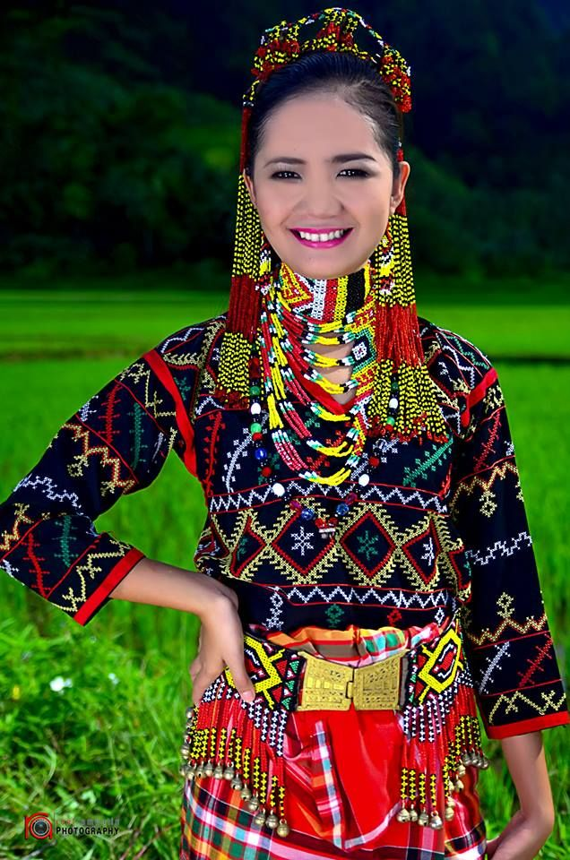

6. CONVEYANCE OF BEAUTY
represent beauty for its own sake--- expression
Ex: face and body makeup, fashion, decorative body accessories

Slide 13
ELEMENTS of ART
The building blocks, the ingredients, the component

Slide 14
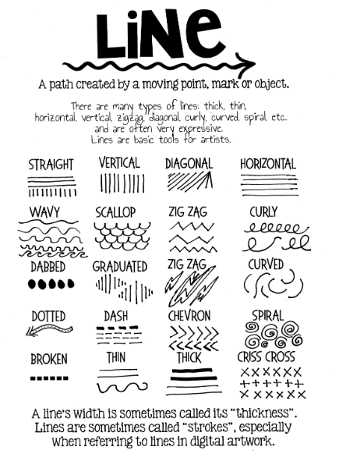
LINES
What is the direction?
Implies? Depict? Represents?

Slide 15
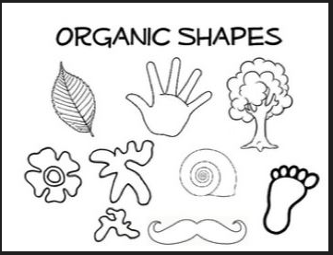

SHAPE Implies? Depict? Represents?
ORGANIC SHAPES
GEOMETRICAL SHAPES

Slide 16
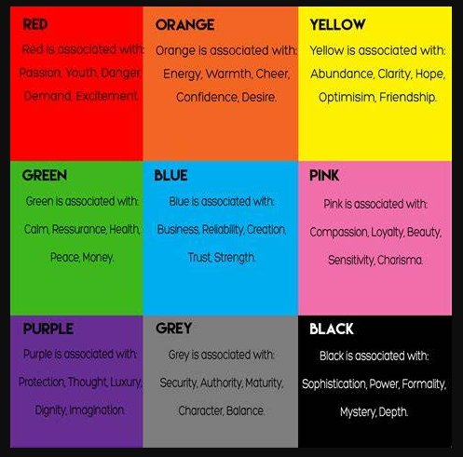
COLOR
Symbolizes?
The psychology of color

Slide 17
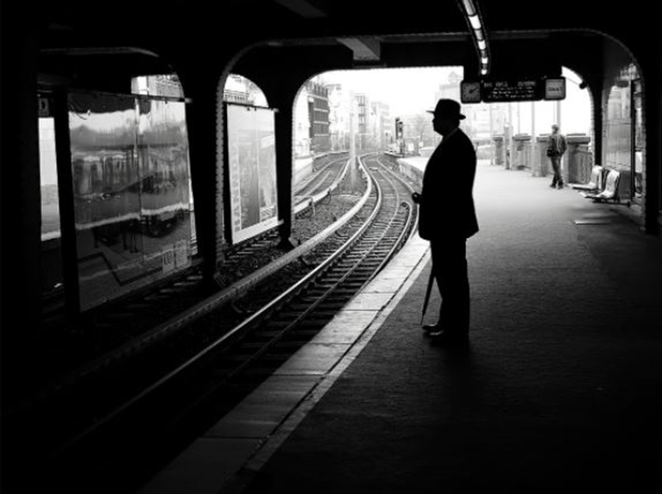
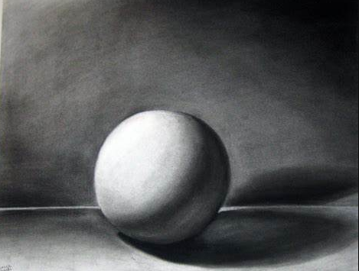
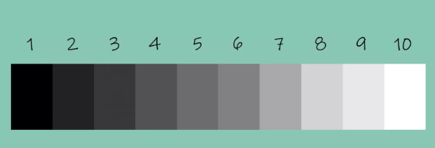
VALUE
The lightness and darkness
Gradual transition from light to dark
The presence of light
The absence of dark

Slide 18
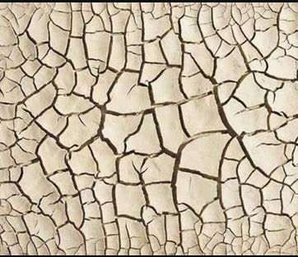
TEXTURE
The feel
The touch
The implied feelings

Slide 19
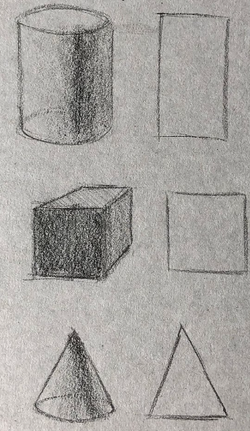
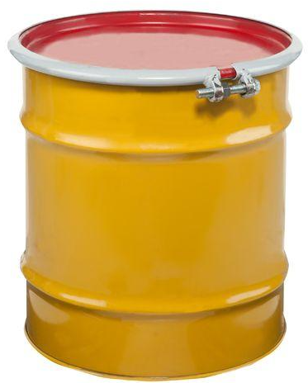


FORM
The details
The complete appearance
The volume,
The thickness
The depth

Slide 20
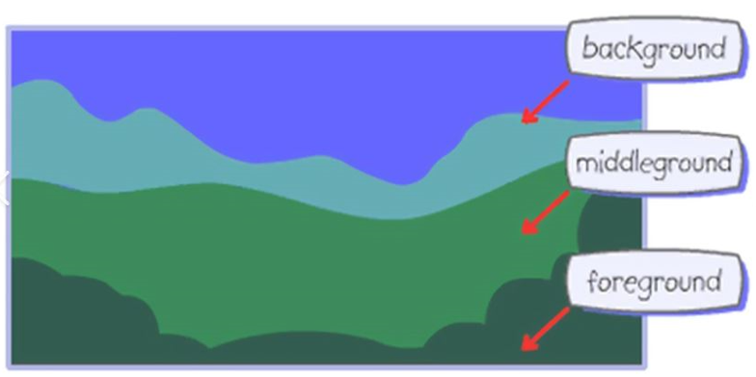
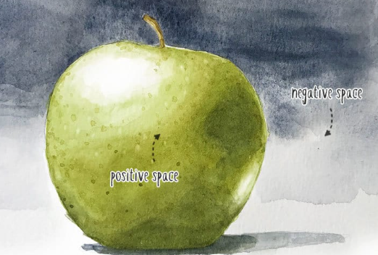
SPACE
The positive
The negative
The distance
The perspective
Foreground
Background

Slide 21

Observe and analyze the portrayal of the seven elements in the image provided.

Slide 22
References:
Content: Reading Visual Arts
Elaine Grace J. Dizon Ph. D.
First Edition
Images borrowed from Google

